Slide 1


NIH OFFICE OF EXTRAMURAL RESEARCH
February 2007
WOMEN SUPPORTED BY
RUTH L. KIRSCHSTEIN
NRSA INDIVIDUAL FELLOWSHIPS
Notes:
Source:
Slide Created: April 2007

Slide 2
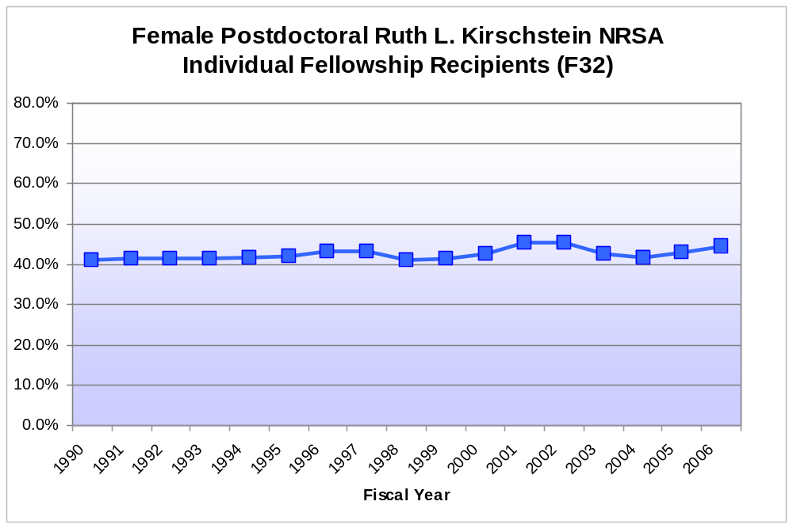
INDIVIDUAL FELLOWSHIP RECIPIENTS (F32)
Notes:
Source:
Slide Created: April 2007

Slide 3
NIH RESEARCH FELLOWSHIP AWARDS
FY 1990 - 2005
Total | Female | Male | Female as % of coded
Postdoctoral Fellow (F32)
1,654 | 515 | 737 | 41.1%
1,660 | 551 | 776 | 41.5%
1,645 | 581 | 821 | 41.4%
1,637 | 622 | 883 | 41.3%
1,710 | 653 | 917 | 41.6%
1,877 | 735 | 1,011 | 42.1%
1,941 | 780 | 1,024 | 43.2%
1,950 | 780 | 1,027 | 43.2%
1,878 | 719 | 1,029 | 41.1%
1,910 | 748 | 1,053 | 41.5%
1,851 | 744 | 1,003 | 42.6%
1,805 | 786 | 943 | 45.5%
1,656 | 721 | 870 | 45.3%
1,614 | 669 | 897 | 42.7%
1,577 | 646 | 901 | 41.8%
1,587 | 671 | 837 | 44.5%
Notes:
Source:
Slide Created: April 2007

Slide 4
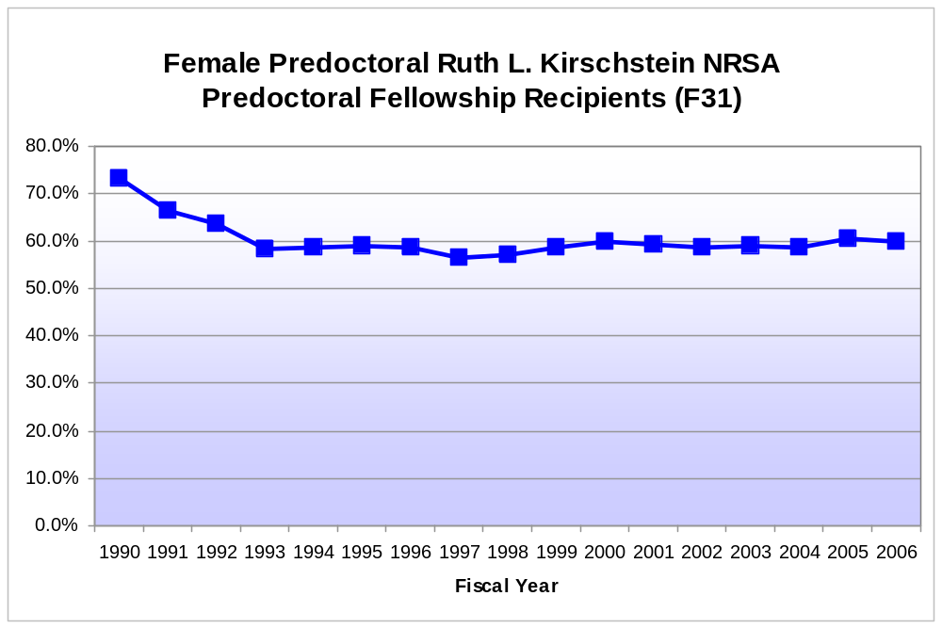
PREDOCTORAL FELLOWSHIP RECIPIENTS (F31)
Notes:
Source:
Slide Created: April 2007

Slide 5
NIH RESEARCH FELLOWSHIP AWARDS
FY 1990 - 2006
FY | Total | Female | Male | Female as % of coded
Pre-Doc Fellowship (F30, F31)
1990 | 334 | 172 | 63 | 73.2%
1991 | 512 | 275 | 140 | 66.3%
1992 | 531 | 277 | 159 | 63.5%
1993 | 587 | 314 | 224 | 58.4%
1994 | 646 | 348 | 247 | 58.5%
1995 | 625 | 341 | 239 | 58.8%
1996 | 673 | 375 | 264 | 58.7%
1997 | 665 | 358 | 275 | 56.6%
1998 | 664 | 358 | 271 | 56.9%
1999 | 692 | 380 | 268 | 58.6%
2000 | 741 | 410 | 275 | 59.9%
2001 | 907 | 498 | 343 | 59.2%
2002 | 1,021 | 566 | 401 | 58.5%
2003 | 1,111 | 623 | 437 | 58.8%
2006 | 1,370 | 785 | 529 | 59.7%
Notes:
Source:
Slide Created: April 2007

Slide 6
NIH OFFICE OF EXTRAMURAL RESEARCH
February 2007
WOMEN ON
NIH CAREER AWARDS
Notes:
Source:
Slide Created: February 2007

Slide 7
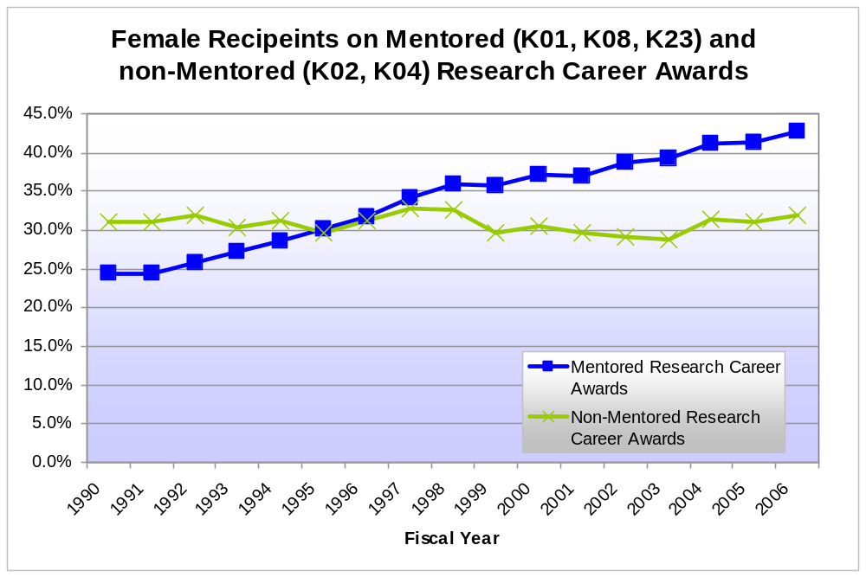
NIH RESEARCH CAREER DEVELOPMENT AWARDS
Notes:
Source:
Slide Created: February 2007

Slide 8
NIH RESEARCH CAREER DEVELOPMENT AWARDS
FY 1990 - 2005
FY | Total | Female | Male | Female as % of coded
Mentored Research Career (K01, K08, K23)
1990 | 549 | 120 | 373 | 24.3%
1991 | 573 | 128 | 395 | 24.5%
1992 | 620 | 148 | 427 | 25.7%
1993 | 686 | 176 | 469 | 27.3%
1994 | 784 | 217 | 541 | 28.6%
1995 | 849 | 249 | 577 | 30.1%
1996 | 1,016 | 312 | 670 | 31.8%
1997 | 1,194 | 395 | 758 | 34.3%
1998 | 1,398 | 481 | 856 | 36.0%
1999 | 1,602 | 545 | 979 | 35.8%
2000 | 1,941 | 676 | 1,140 | 37.2%
2001 | 2,166 | 749 | 1,275 | 37.0%
2002 | 2,428 | 876 | 1,389 | 38.7%
2003 | 2,719 | 998 | 1,541 | 39.3%
2004 | 2,928 | 1,131 | 1,621 | 41.1%
2005 | 3,045 | 1,195 | 1,698 | 41.3%
2006 | 3,018 | 1,222 | 1,633 | 42.8%
FY | Total | Female | Male | Female as % of coded
Other Research Career (K02, K24)
1990 | 119 | 36 | 80 | 31.0%
1991 | 121 | 37 | 82 | 31.1%
1992 | 118 | 37 | 79 | 31.9%
1993 | 136 | 40 | 92 | 30.3%
1994 | 146 | 44 | 97 | 31.2%
1995 | 152 | 44 | 104 | 29.7%
1996 | 192 | 58 | 128 | 31.2%
1997 | 225 | 72 | 147 | 32.9%
1998 | 256 | 81 | 168 | 32.5%
1999 | 358 | 103 | 244 | 29.7%
2000 | 456 | 135 | 307 | 30.5%
2001 | 509 | 148 | 350 | 29.7%
2002 | 539 | 153 | 372 | 29.1%
2003 | 565 | 159 | 393 | 28.8%
2004 | 519 | 159 | 347 | 31.4%
2005 | 513 | 156 | 347 | 31.0%
2006 | 482 | 151 | 321 | 32.0%
Notes:
Source:
Slide Created: February 2007

Slide 9
NIH OFFICE OF EXTRAMURAL RESEARCH
February 2007
PARTICIPATION OF WOMEN ON ALL RESEARCH TRAINING AND CAREER DEVELOPMENT ACTIVITIES
Notes:
Source:
Slide Created: February 2007

Slide 10
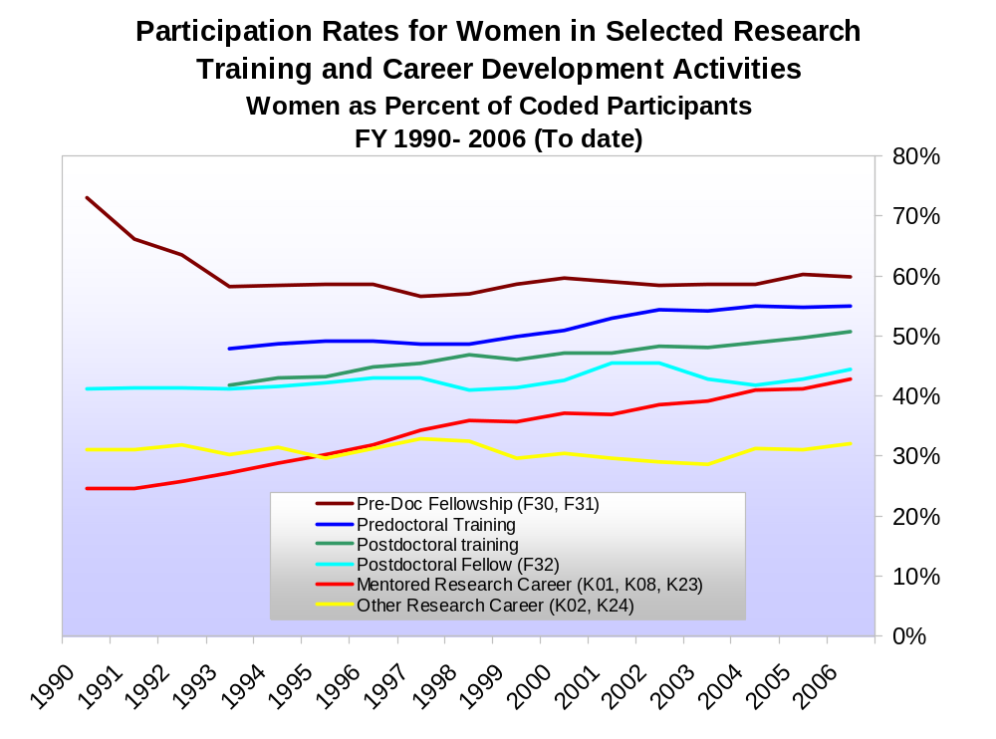
PARTICIPATION OF WOMEN ON ALL RESEARCH TRAINING AND CAREER DEVELOPMENT ACTIVITIES
Notes:
Source:
Slide Created: February 2007

Slide 11
NIH OFFICE OF EXTRAMURAL RESEARCH
February 2007
WOMEN PRINCIPAL INVESTIGATORS ON NIH RESEARCH GRANTS
Notes:
Source:
Slide Created: February 2007

Slide 12
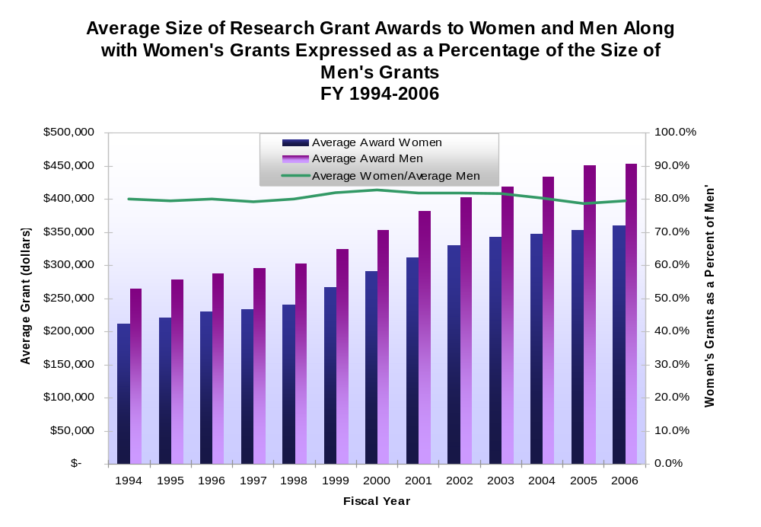
WOMEN PRINCIPAL INVESTIGATORS ON NIH RESEARCH GRANTS
Notes:
Source:
Slide Created: February 2007

Slide 13
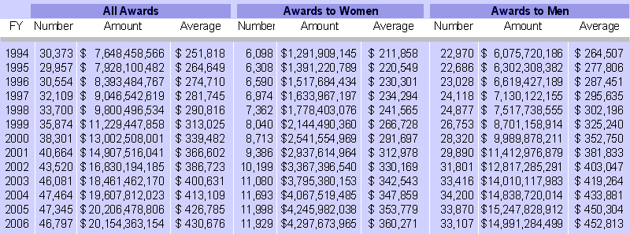
NIH COMPETING AND NON-COMPETING
RESEARCH GRANT AWARDS, FY 1994-2006
Notes:
Source:
Slide Created: February 2007

Slide 14
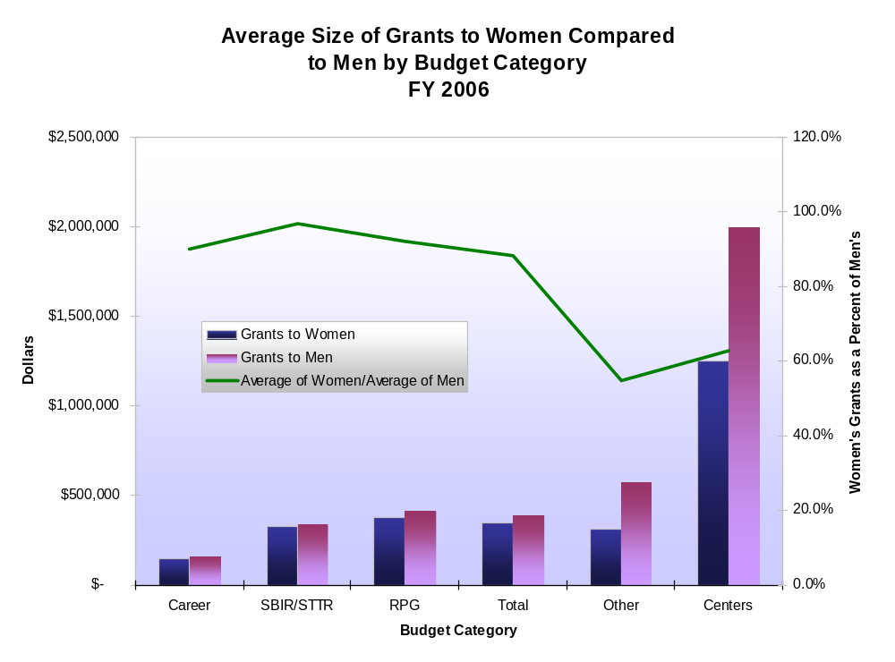
AVERAGE SIZE OF NIH RESEARCH GRANTS
BY BUDGET CATEGORY
Notes:
Source:
Slide Created: February 2007

Slide 15
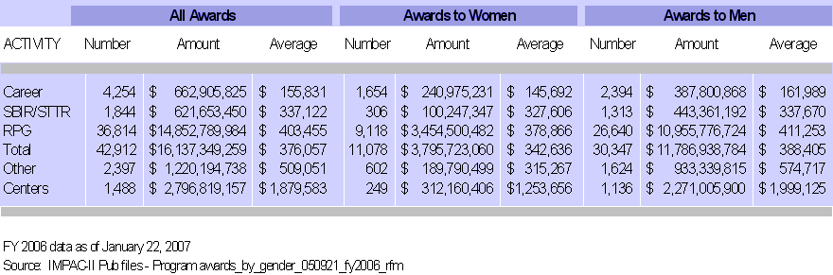
NIH RESEARCH GRANTS BY
BUDGET CATEGORY, FY 2006
Notes:
Source: FY 2006 data as of January 22, 2007; IMPAC II Pubfiles – Programawards_by_gender_050921_fy2006_rfm
Slide Created: February 2007

Slide 16
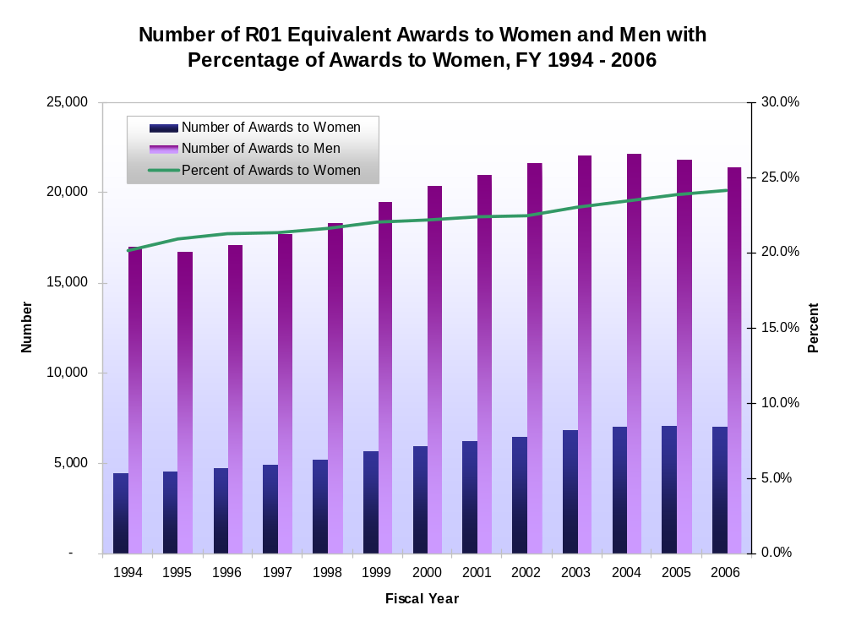
NUMBER OF R01 EQUIVALENT AWARDS
Notes:
Source:
Slide Created: February 2007

Slide 17
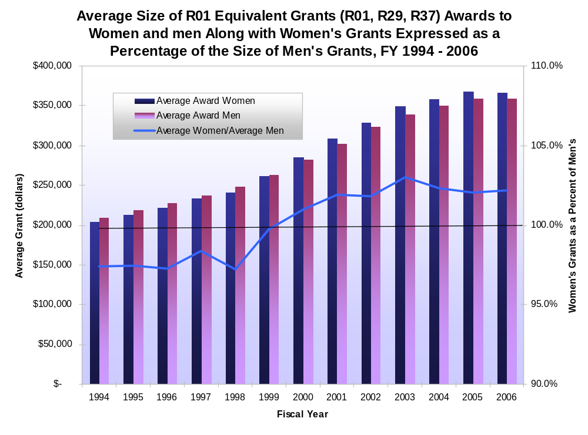
AVERAGE SIZE OF R01 EQUIVALENT AWARDS
Notes:
Source:
Slide Created: February 2007

Slide 18
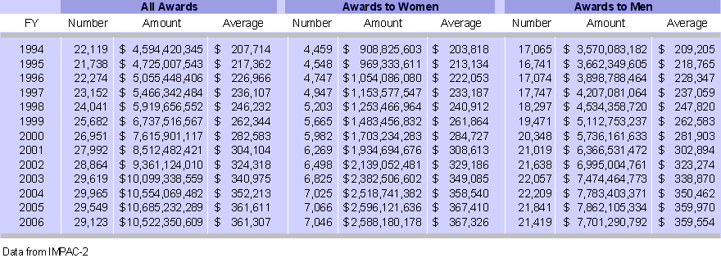
NIH COMPETING AND NON-COMPETING
R01 EQUIVALENT AWARDS, FY 1994-2006
Notes:
Source: Data from IMPAC-II
Slide Created: February 2007

Slide 19
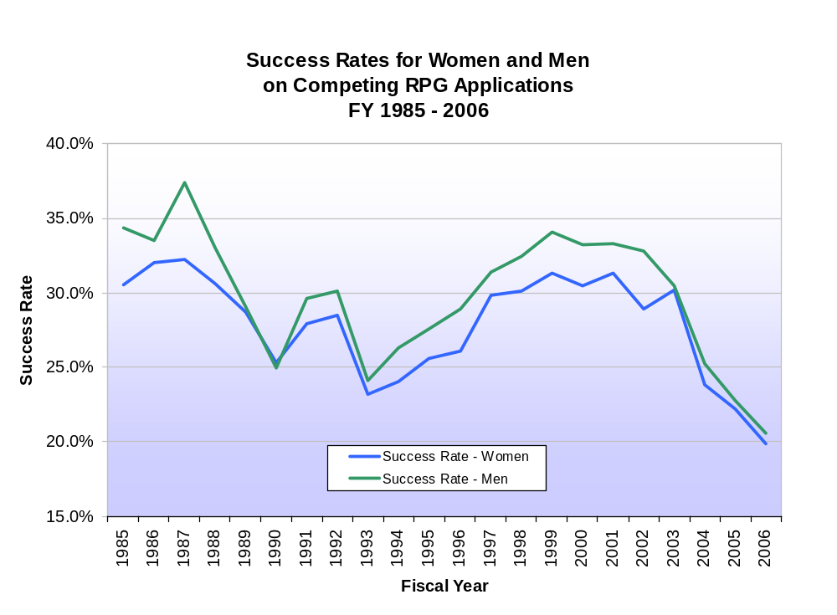
SUCCESS RATES ON
COMPETING RPG APPLICATIONS
Notes:
Source:
Slide Created: February 2007

Slide 20
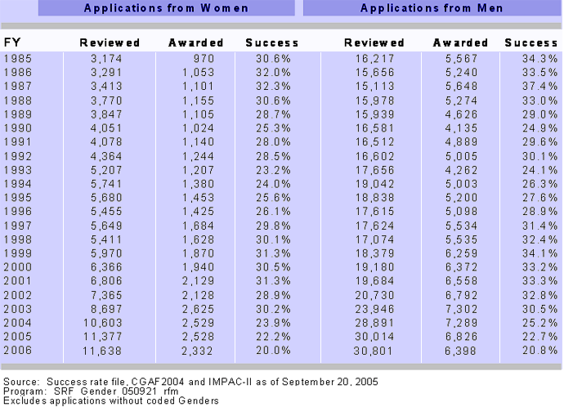
SUCCESS RATES FOR WOMEN AND MEN ON NIH COMPETING
RESEARCH PROJECT GRANT APPLICATIONS, FY 1985 - 2006
Notes:
Source: Success Rate file CGAF 2004 and IMPAC II as of September 20, 2005
Program: SRF Gender 050921.rfm
Excludes applications without Coded Genders
Slide Created: February 2007

